Slide 2
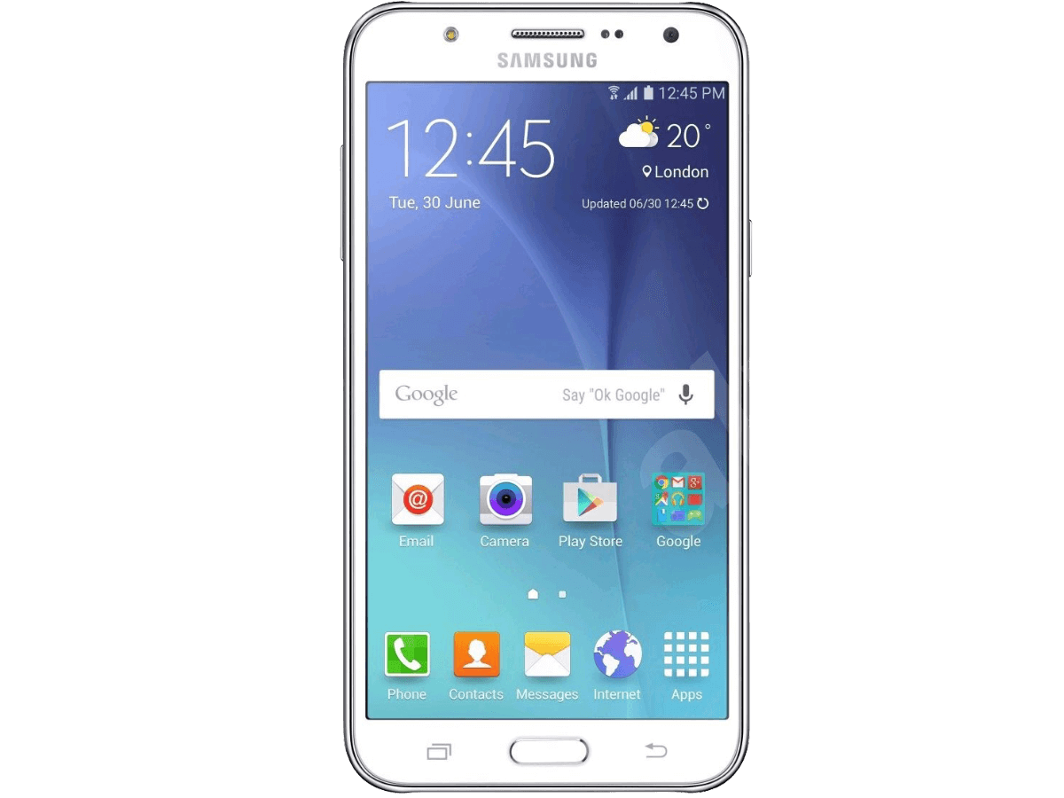
Cellular
International Mobile Equipment Identity
Worldwide hardware identifier
GSM and UTMS networks
Potential for spoofing
International Mobile Subscriber Identity
Worldwide unique subscriber identifier
GSM and UTMS networks
Stored in Subscriber Identity Modules(SIM)
Notes:
15- or 17-digit code that uniquely identifies mobile phone sets.
The IMEI code can enable a GSM (Global System for Mobile communication) or UMTS (Universal Mobile Telecommunications Service) network to prevent a misplaced or stolen phone from initiating calls.

Slide 3

Wi-Fi
IEEE 802.11* standard
.11a – Wi-Fi 2 ( 54 Mbps, 5 GHz)
.11b – Wi-Fi 1 ( 11 Mbps, 2.4 GHz)
.11g – Wi-Fi 3 ( 54 Mbps, 2.4 GHz)
.11n – Wi-Fi 4 ( 2.4/5 GHz, 600 Mbps)
.11ac – Wi-Fi 5 (5 GHz, 3.6 Gbps)
.11ax – Wi-Fi 6 (2.4/5/6 GHz 14 Gbps)
Notes:
WiFi 1 = 1999
WiFi 2 = 1999
WiFi 3 = 2003
WiFi 4 = 2009
WiFi 5 = 2014
WiFi 6 = 2019

Slide 4

Near Field Communication (NFC)
Short-range communication
(10cm/4 inches)
13.56 MHz base frequency
Simple setup
File/data transfer
Notes:
Client presents the list of supported cipher suite

Slide 5
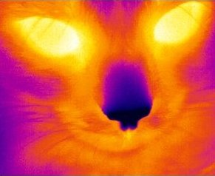
Infrared
Short-range communication
1 meter/3.28 ft
Sensitive LoS communication
IrDA
16 Mbps
Notes:
Client presents the list of supported cipher suite

Slide 6

Bluetooth
Data transfer
Fixed and mobile devices
Discovery and pairing
2.4 GHz spectrum
Notes:
Enhanced Data Rate

Slide 7
Bluetooth Standards
1.0,1.2(legacy) = 732 Kbps
2.0, 2.1 (+EDR) = 3 Mbps
3.0 (+HS) = 24 Mbps
4.0/4.2 (+BLE) = 3 Mbps
Notes:
Enhanced Data Rate
High speed
Bluetooth low energy

Slide 8

Universal Serial Bus
Point-to-point communications
Data transfer
Standards
1.1 (Full speed) = 12 Mbps
2.0 (High speed) = 480 Mbps
3.2 Gen 1 (SuperSpeed) = 5 Gbps
3.2 Gen 2 (SuperSpeed+) = 10 Mbps
3.2 Gen 2x2 (SuperSpeed 10Gbps) = 20 Gbps
USB 4 (USB4 Gen3x2 40 Gbps) = 40 Gbps
Notes:
Client presents the list of supported cipher suite

Slide 9
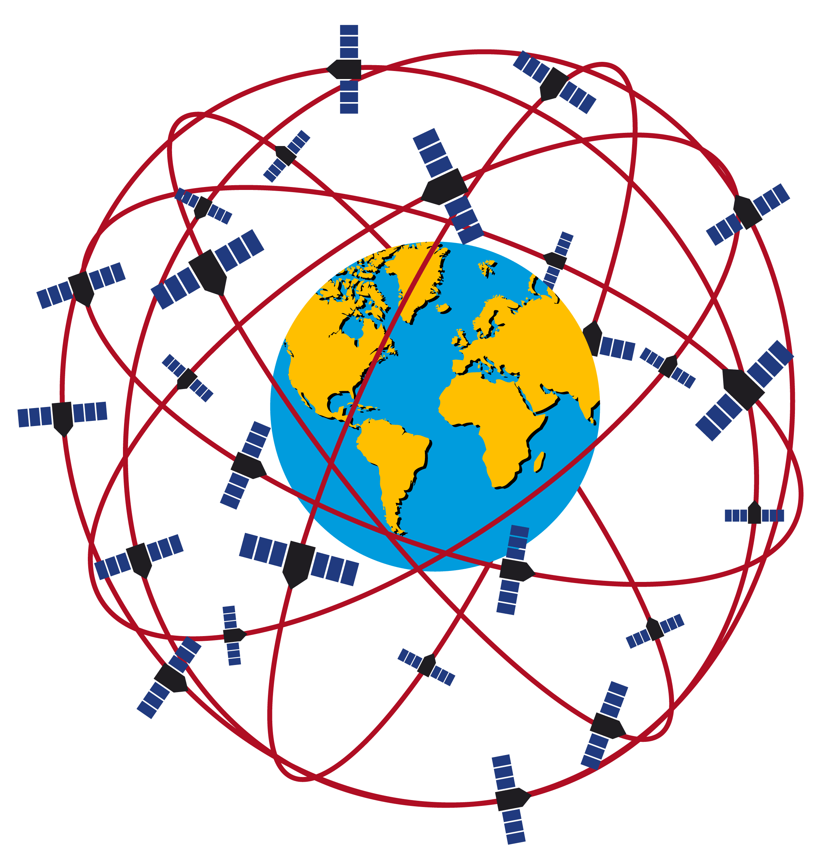
Global Positioning System
Components
Space segment
Control segment
User segment
Global Navigation Satellite Systems
GPS (US)
GLONASS (Russia)
Galileo (EU)
BeiDou (China)
Notes:
Space segment = 24 operational satellites, 3 stand-by (27 total), transmitting one-way signals
Control segment = worldwide monitoring system, control stations (command maneuvers)
User segment = GPS receiver

Slide 10

Radio Frequency Identifier
Electromagnetic fields
Identify and track tags
Tags attached to objects
Tag types
Passive tags = powered by RFID reader
Active tags = battery powered
Notes:
Client presents the list of supported cipher suite

Slide 11





Security Concerns
Eavesdropping
Data leaks
Replay attacks
Spoofing attacks
Unauthorized use
Notes:
Bluesnarfing = data theft
Bluejacking = unauthorized use
PII, proprietary information

